Slide 1
Karatina University
COM 210: Structured Programming
Lecture 07: Control structures

Slide 2
1. Introduction
Before writing a program to solve a particular problem, it’s essential to have a thorough understanding of the problem and a carefully planned approach to solving the problem.
Sequence
Selection
Iteration

Slide 3
2. Algorithms
The solution to any computing problem involves executing a series of actions in a specific order.
A procedure for solving a problem in terms of
  the actions to be executed, and
  the order in which these actions are to be executed is called an algorithm.
Correctly specifying the order in which the actions are to be executed is important.

Slide 4
2. Algorithms (Cont.)
Consider the “rise-and-shine algorithm” followed by one junior executive for getting out of bed and going to work: Consider the “rise-and-shine algorithm” followed by one junior executive for getting out of bed and going to work: (1) Get out of bed, (2) take off pajamas, (3) take a shower, (4) get dressed, (5) eat breakfast, (6) carpool to work.
This routine gets the executive to work well prepared to make critical decisions.

Slide 5
2. Algorithms (Cont.)
Suppose that the same steps are performed in a slightly different order: (1) Get out of bed, (2) take off pajamas, (3) get dressed, (4) take a shower, (5) eat breakfast, (6) carpool to work.
In this case, our junior executive shows up for work soaking wet.
Specifying the order in which statements are to be executed in a computer program is called program control.

Slide 6
3. Pseudocode
Pseudocode is an artificial and informal language that helps you develop algorithms.
Pseudocode is similar to everyday English; it’s convenient and user friendly although it’s not an actual computer programming language.
Pseudocode programs are not executed on computers.
Rather, they merely help you “think out” a program before attempting to write it in a programming language such as C.
Pseudocode consists purely of characters, so you may conveniently type pseudocode programs into a computer using an editor program.

Slide 7
3. Pseudocode (Cont.)
A carefully prepared pseudocode program may be converted easily to a corresponding C program.
Pseudocode consists only of action statements—those that are executed when the program has been converted from pseudocode to C and is run in C.
Definitions are not executable statements.
They’re messages to the compiler.

Slide 8
3. Pseudocode (Cont.)
For example, the definition
    int i;
simply tells the compiler the type of variable i and instructs the compiler to reserve space in memory for the variable.
But this definition does not cause any action—such as input, output, or a calculation—to occur when the program is executed.
Some programmers choose to list each variable and briefly mention the purpose of each at the beginning of a pseudocode program.

Slide 9
4. Control Structures
Normally, statements in a program are executed one after the other in the order in which they’re written.
This is called sequential execution.
Various C statements enable you to specify that the next statement to be executed may be other than the next one in sequence.
This is called transfer of control.
During the 1960s, it became clear that the indiscriminate use of transfers of control was the root of a great deal of difficulty experienced by software development groups.

Slide 10
4. Control Structures (Cont.)
The finger of blame was pointed at the goto statement that allows programmers to specify a transfer of control to one of many possible destinations in a program.
The notion of so-called structured programming became almost synonymous with “goto elimination.”
Research had demonstrated that programs could be written without any goto statements.
The challenge of the era was for programmers to shift their styles to “goto-less programming.”

Slide 11
4. Control Structures (Cont.)
The results were impressive, as software development groups reported reduced development times, more frequent on-time delivery of systems and more frequent within-budget completion of software projects.
Programs produced with structured techniques were clearer, easier to debug and modify and more likely to be bug free in the first place.
Research had demonstrated that all programs could be written in terms of only three control structures, namely the sequence structure, the selection structure and the repetition structure.

Slide 12
4. Control Structures (Cont.)
The sequence structure is built into C.
Unless directed otherwise, the computer executes C statements one after the other in the order in which they’re written.
The flowchart segment of Fig. 3.1 illustrates C’s sequence structure.
A flowchart is a graphical representation of an algorithm or of a portion of an algorithm.
Flowcharts are drawn using certain special-purpose symbols such as rectangles, diamonds, ovals, and small circles; these symbols are connected by arrows called flowlines.

Slide 13
4. Control Structures (Cont.)
Like pseudocode, flowcharts are useful for developing and representing algorithms, although pseudocode is preferred by most programmers.
Consider the flowchart for the sequence structure in Fig. 3.1.
We use the rectangle symbol, also called the action symbol, to indicate any type of action including a calculation or an input/output operation.
The flowlines in the figure indicate the order in which the actions are performed—first, grade is added to total, then 1 is added to counter.
C allows us to have as many actions as we want in a sequence structure.

Slide 14
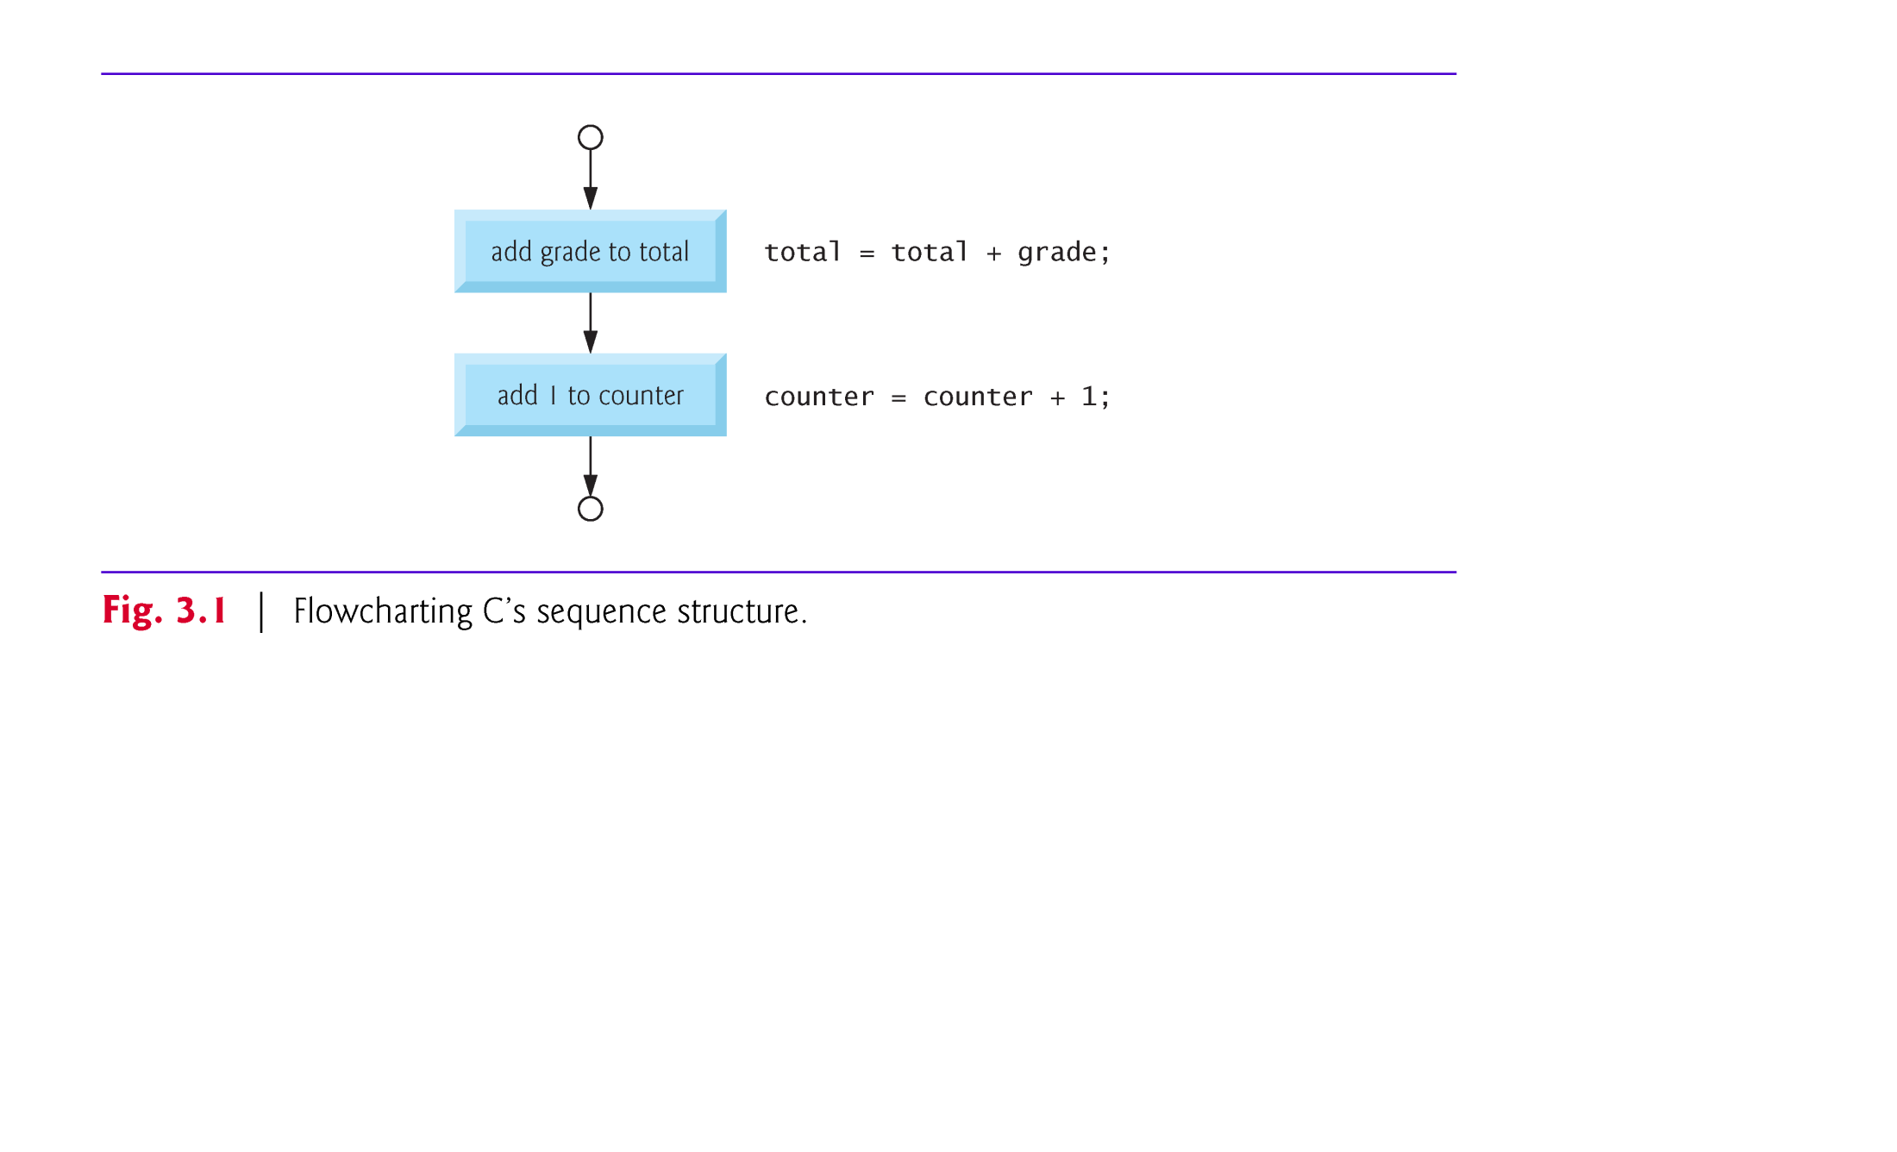

Slide 15
4. Control Structures (Cont.)
When drawing a flowchart that represents a complete algorithm, an oval symbol containing the word “Begin” is the first symbol used in the flowchart; an oval symbol containing the word “End” is the last symbol used.
When drawing only a portion of an algorithm as in Fig. 3.1, the oval symbols are omitted in favor of using small circle symbols, also called connector symbols.
Perhaps the most important flowcharting symbol is the diamond symbol, also called the decision symbol, which indicates that a decision is to be made.

Slide 16
4. Control Structures: Selection structures
C provides three types of selection structures in the form of statements.
The if selection statement (Section 5) either performs (selects) an action if a condition is true or skips the action if the condition is false.
The if…else selection statement (Section 6) performs an action if a condition is true and performs a different action if the condition is false.
The switch selection statement performs one of many different actions depending on the value of an expression.

Slide 17
4. Control Structures (Cont.)
The if statement is called a single-selection statement because it selects or ignores a single action.
The if…else statement is called a double-selection statement because it selects between two different actions.
The switch statement is called a multiple-selection statement because it selects among many different actions.
C provides three types of repetition structures in the form of statements, namely while (Section 7), do…while, and for

Slide 18
4. Control Structures (Cont.)
The control-statement flowchart segments can be attached to one another by connecting the exit point of one control statement to the entry point of the next.
This is much like the way in which a child stacks building blocks, so we call this control-statement stacking.
We’ll learn that there is only one other way control statements may be connected—a method called control-statement nesting.
Thus, any C program we’ll ever need to build can be constructed from only seven different types of control statements combined in only two ways.
This is the essence of simplicity.

Slide 19
5 The if Selection Statement
Selection structures are used to choose among alternative courses of action.
For example, suppose the passing grade on an exam is 60.
The pseudocode statement
  If student’s grade is greater than or equal to 60
  Print “Passed”
determines if the condition “student’s grade is greater than or equal to 60” is true or false.
If the condition is true, then “Passed” is printed, and the next pseudocode statement in order is “performed” (remember that pseudocode is not a real programming language).

Slide 20
5 The if Selection Statement (Cont.)
If the condition is false, the printing is ignored, and the next pseudocode statement in order is performed.
The second line of this selection structure is indented.
Such indentation is optional, but it’s highly recommended as it helps emphasize the inherent structure of structured programs.
The C compiler ignores white-space characters like blanks, tabs and newlines used for indentation and vertical spacing.

Slide 21
5. The if Selection Statement (Cont.)
The preceding pseudocode If statement may be written in C as
    if ( grade >= 60 ) {
    printf( "Passed\n" );
    } /* end if */
Notice that the C code corresponds closely to the pseudocode.

Slide 22
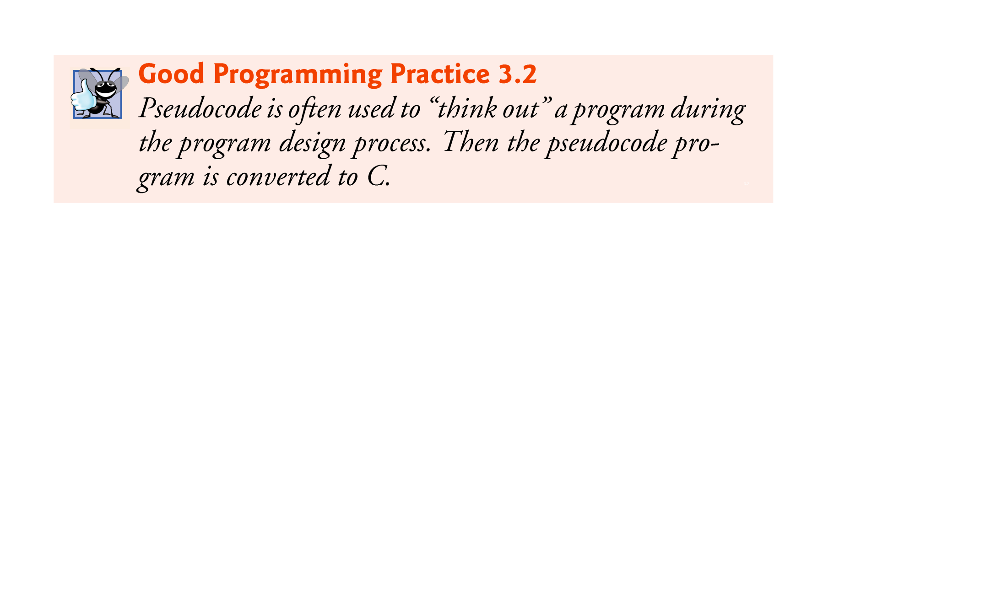

Slide 23
5. The if Selection Statement (Cont.)
The flowchart of Fig. 3.2 illustrates the single-selection if statement.
This flowchart contains what is perhaps the most important flowcharting symbol—the diamond symbol, also called the decision symbol, which indicates that a decision is to be made.
The decision symbol contains an expression, such as a condition, that can be either true or false.

Slide 24
5. The if Selection Statement (Cont.)
The decision symbol has two flowlines emerging from it.
One indicates the direction to take when the expression in the symbol is true; the other indicates the direction to take when the expression is false.
Decisions can be based on conditions containing relational or equality operators.
In fact, a decision can be based on any expression—if the expression evaluates to zero, it’s treated as false, and if it evaluates to nonzero, it’s treated as true.

Slide 25
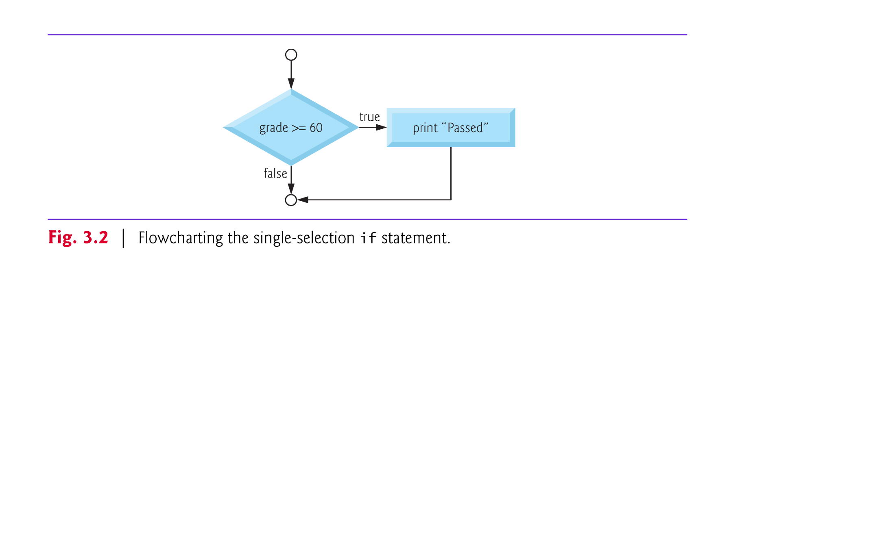

Slide 26
5. The if Selection Statement (Cont.)
The if statement, too, is a single-entry/single-exit structure.
These flowchart segments are empty—nothing is written in the rectangles and nothing is written in the diamonds.
Your task, then, is assembling a program from as many of each type of control statement as the algorithm demands, combining those control statements in only two possible ways (stacking or nesting), and then filling in the actions and decisions in a manner appropriate for the algorithm.

Slide 27
6. The if…else Selection Statement
The if…else selection statement allows you to specify that different actions are to be performed when the condition is true than when the condition is false.
For example, the pseudocode statement
  If student’s grade is greater than or equal to 60
  Print “Passed”
  else
  Print “Failed”
prints Passed if the student’s grade is greater than or equal to 60 and prints Failed if the student’s grade is less than 60.
In either case, after printing occurs, the next pseudocode statement in sequence is “performed.” The body of the else is also indented.

Slide 28
6. The if…else Selection Statement (Cont.)
The preceding pseudocode If…else statement may be written in C as
    if ( grade >= 60 ) {
    printf( "Passed\n" );
    } /* end if */
    else {
    printf( "Failed\n" );
    } /* end else */
The flowchart of Fig. 3.3 nicely illustrates the flow of control in the if…else statement.
Once again, note that (besides small circles and arrows) the only symbols in the flowchart are rectangles (for actions) and a diamond (for a decision).

Slide 29
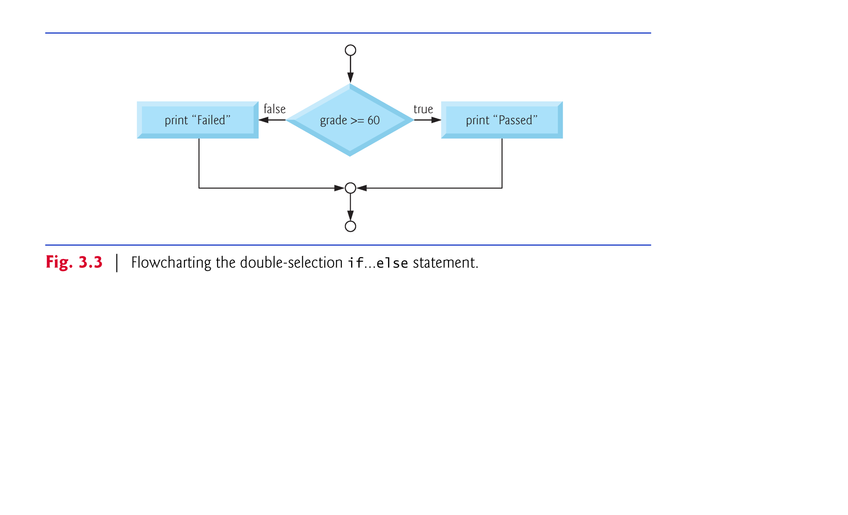

Slide 30
6. The if…else Selection Statement (Cont.)
C provides the conditional operator (?:) which is closely related to the if…else statement.
The conditional operator is C’s only ternary operator—it takes three operands.
The operands together with the conditional operator form a conditional expression.
The first operand is a condition.
The second operand is the value for the entire conditional expression if the condition is true and
the third operand is the value for the entire conditional expression if the condition is false.

Slide 31
6. The if…else Selection Statement (Cont.)
For example, the printf statement
    printf( "%s\n", grade >= 60 ?
    "Passed" : "Failed" );
contains a conditional expression that evaluates to the string literal "Passed" if the condition grade >= 60 is true and evaluates to the string literal "Failed" if the condition is false.
The format control string of the printf contains the conversion specification %s for printing a character string.
So the preceding printf statement performs in essentially the same way as the preceding if…else statement.

Slide 32
6. The if…else Selection Statement (Cont.)
The second and third operands in a conditional expression can also be actions to be executed.
For example, the conditional expression
    grade >= 60 ? printf( "Passed\n" ) :
    printf( "Failed\n" );
is read, “If grade is greater than or equal to 60 then printf("Passed\n"), otherwise printf( "Failed\n" ).” This, too, is comparable to the preceding if…else statement.
We’ll see that conditional operators can be used in some situations where if…else statements cannot.

Slide 33
6. The if…else Selection Statement (Cont.)
Nested if…else statements test for multiple cases by placing if…else statements inside if…else statements.
For example, the following pseudocode statement will print A for exam grades greater than or equal to 90, B for grades greater than or equal to 80, C for grades greater than or equal to 70, D for grades greater than or equal to 60, and F for all other grades.
  If student’s grade is greater than or equal to 90
  Print “A”
  else
  If student’s grade is greater than or equal to 80
  Print “B”
  else
  If student’s grade is greater than or equal to 70
  Print “C”
  else
  If student’s grade is greater than or equal to 60
  Print “D”
  else
  Print “F”

Slide 34
6. The if…else Selection Statement (Cont.)
This pseudocode may be written in C as
    if ( grade >= 90 )
    printf( "A\n" );
    else
    if ( grade >= 80 )
    printf("B\n");
    else
    if ( grade >= 70 )
    printf("C\n");
    else
    if ( grade >= 60 )
    printf( "D\n" );
    else
    printf( "F\n" );

Slide 35
6. The if…else Selection Statement (Cont.)
If the variable grade is greater than or equal to 90, the first four conditions will be true, but only the printf statement after the first test will be executed.
After that printf is executed, the else part of the “outer” if…else statement is skipped.

Slide 36
6. The if…else Selection Statement (Cont.)
Many C programmers prefer to write the preceding if statement as
    if ( grade >= 90 )
    printf( "A\n" );
    else if ( grade >= 80 )
    printf( "B\n" );
    else if ( grade >= 70 )
    printf( "C\n" );
    else if ( grade >= 60 )
    printf( "D\n" );
    else
    printf( "F\n" );

Slide 37
6. The if…else Selection Statement (Cont.)
As far as the C compiler is concerned, both forms are equivalent.
The latter form is popular because it avoids the deep indentation of the code to the right.
The if selection statement expects only one statement in its body.
To include several statements in the body of an if, enclose the set of statements in braces ({ and }).
A set of statements contained within a pair of braces is called a compound statement or a block.

Slide 38
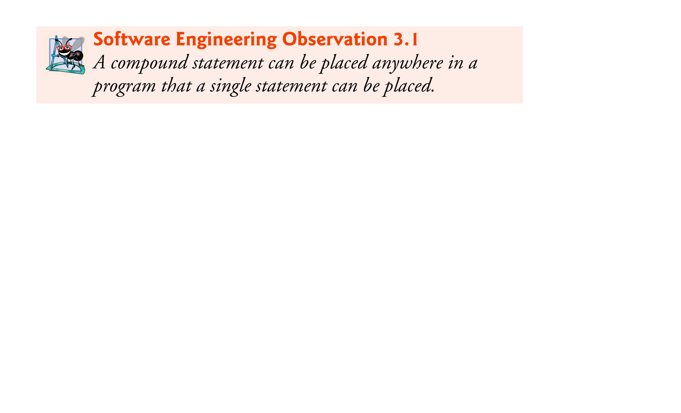

Slide 39
6. The if…else Selection Statement (Cont.)
The following example includes a compound statement in the else part of an if…else statement.
    if ( grade >= 60 ) {
    printf( "Passed.\n" );
    } /* end if */
    else {
    printf( "Failed.\n" );
    printf( "You must take this course again.\n" );
    } /* end else */

Slide 40
6. The if…else Selection Statement (Cont.)
In this case, if grade is less than 60, the program executes both printf statements in the body of the else and prints
    Failed.
    You must take this course again.
Notice the braces surrounding the two statements in the else clause.
These braces are important. Without the braces, the statement
    printf( "You must take this course again.\n" );
would be outside the body of the else part of the if, and would execute regardless of whether the grade was less than 60.

Slide 41
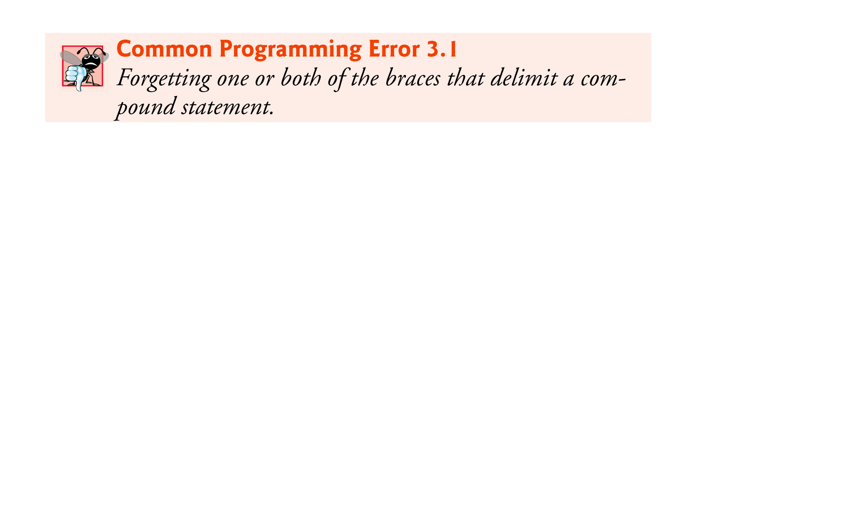

Slide 42
6. The if…else Selection Statement (Cont.)
A syntax error is caught by the compiler.
A logic error has its effect at execution time.
A fatal logic error causes a program to fail and terminate prematurely.
A nonfatal logic error allows a program to continue executing but to produce incorrect results.

Slide 43
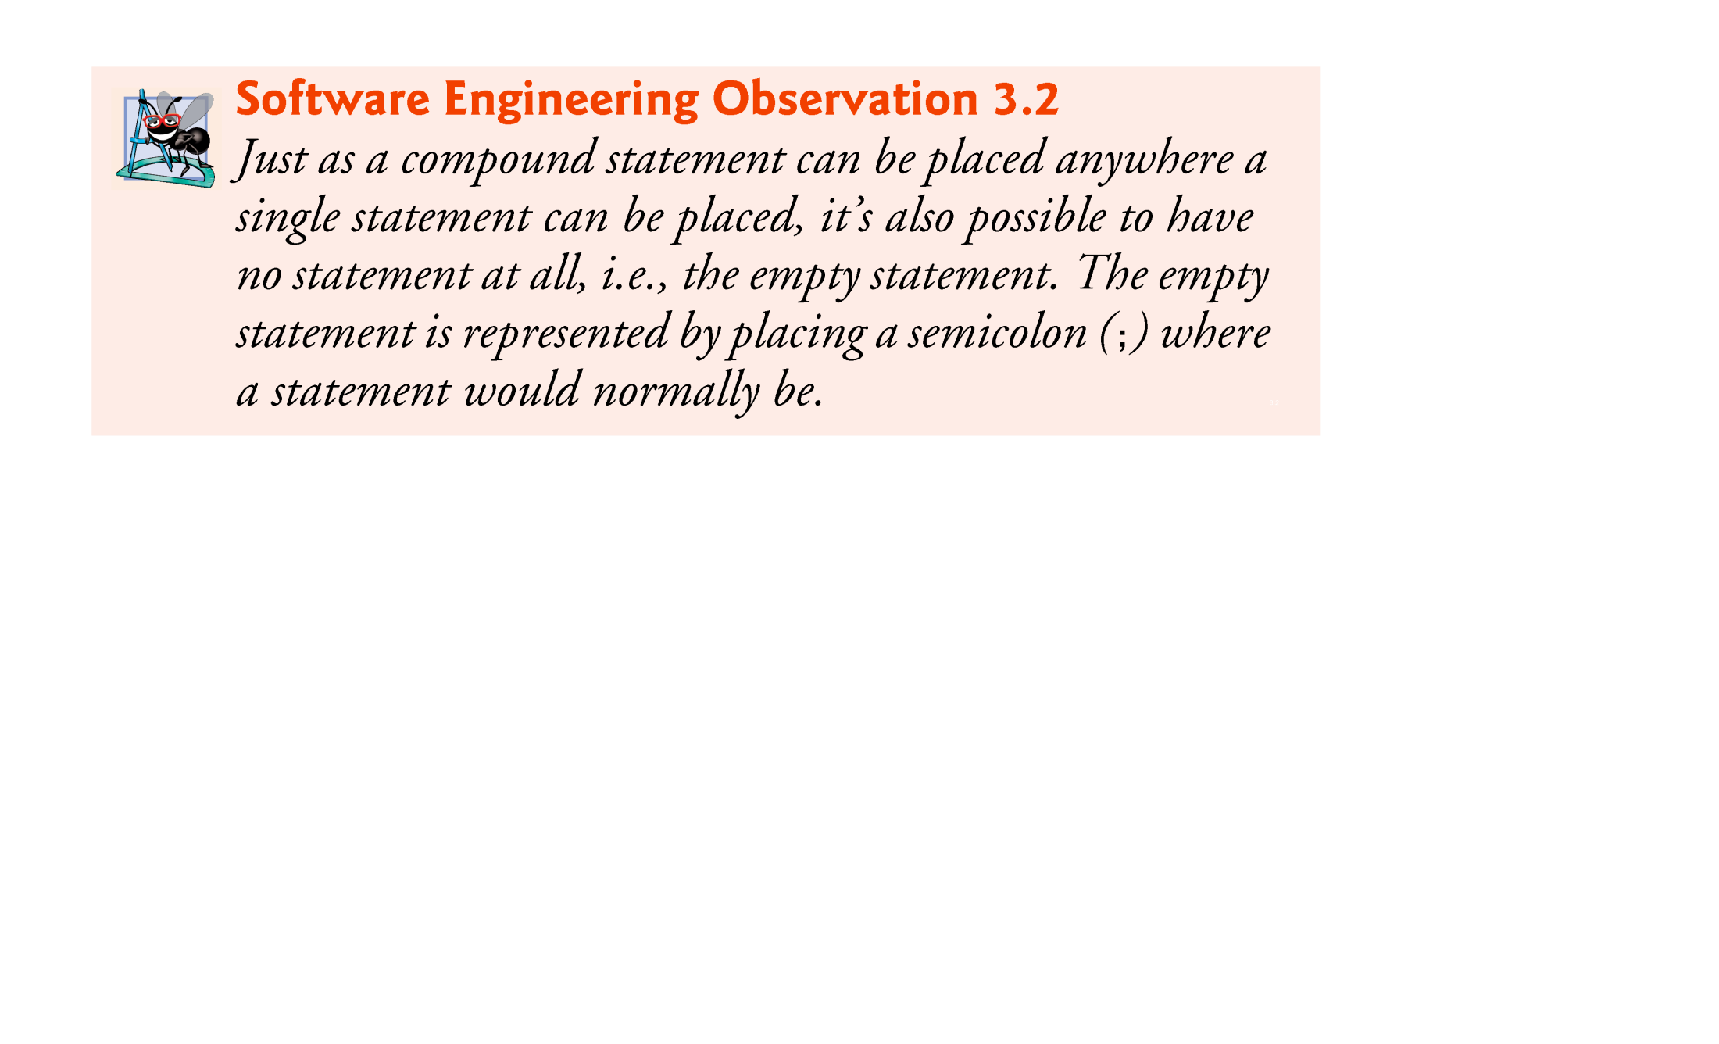

Slide 44
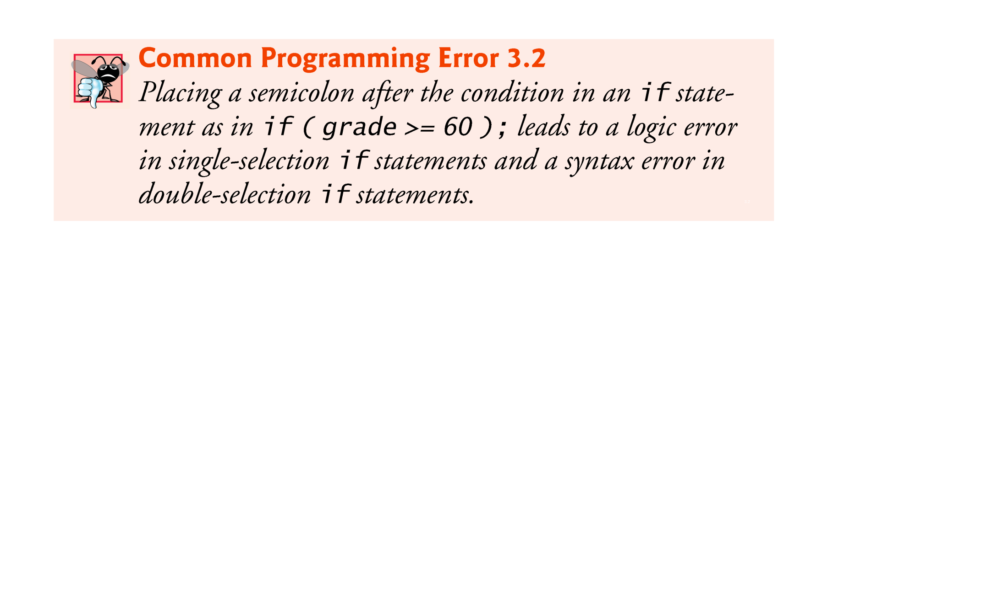

Slide 45
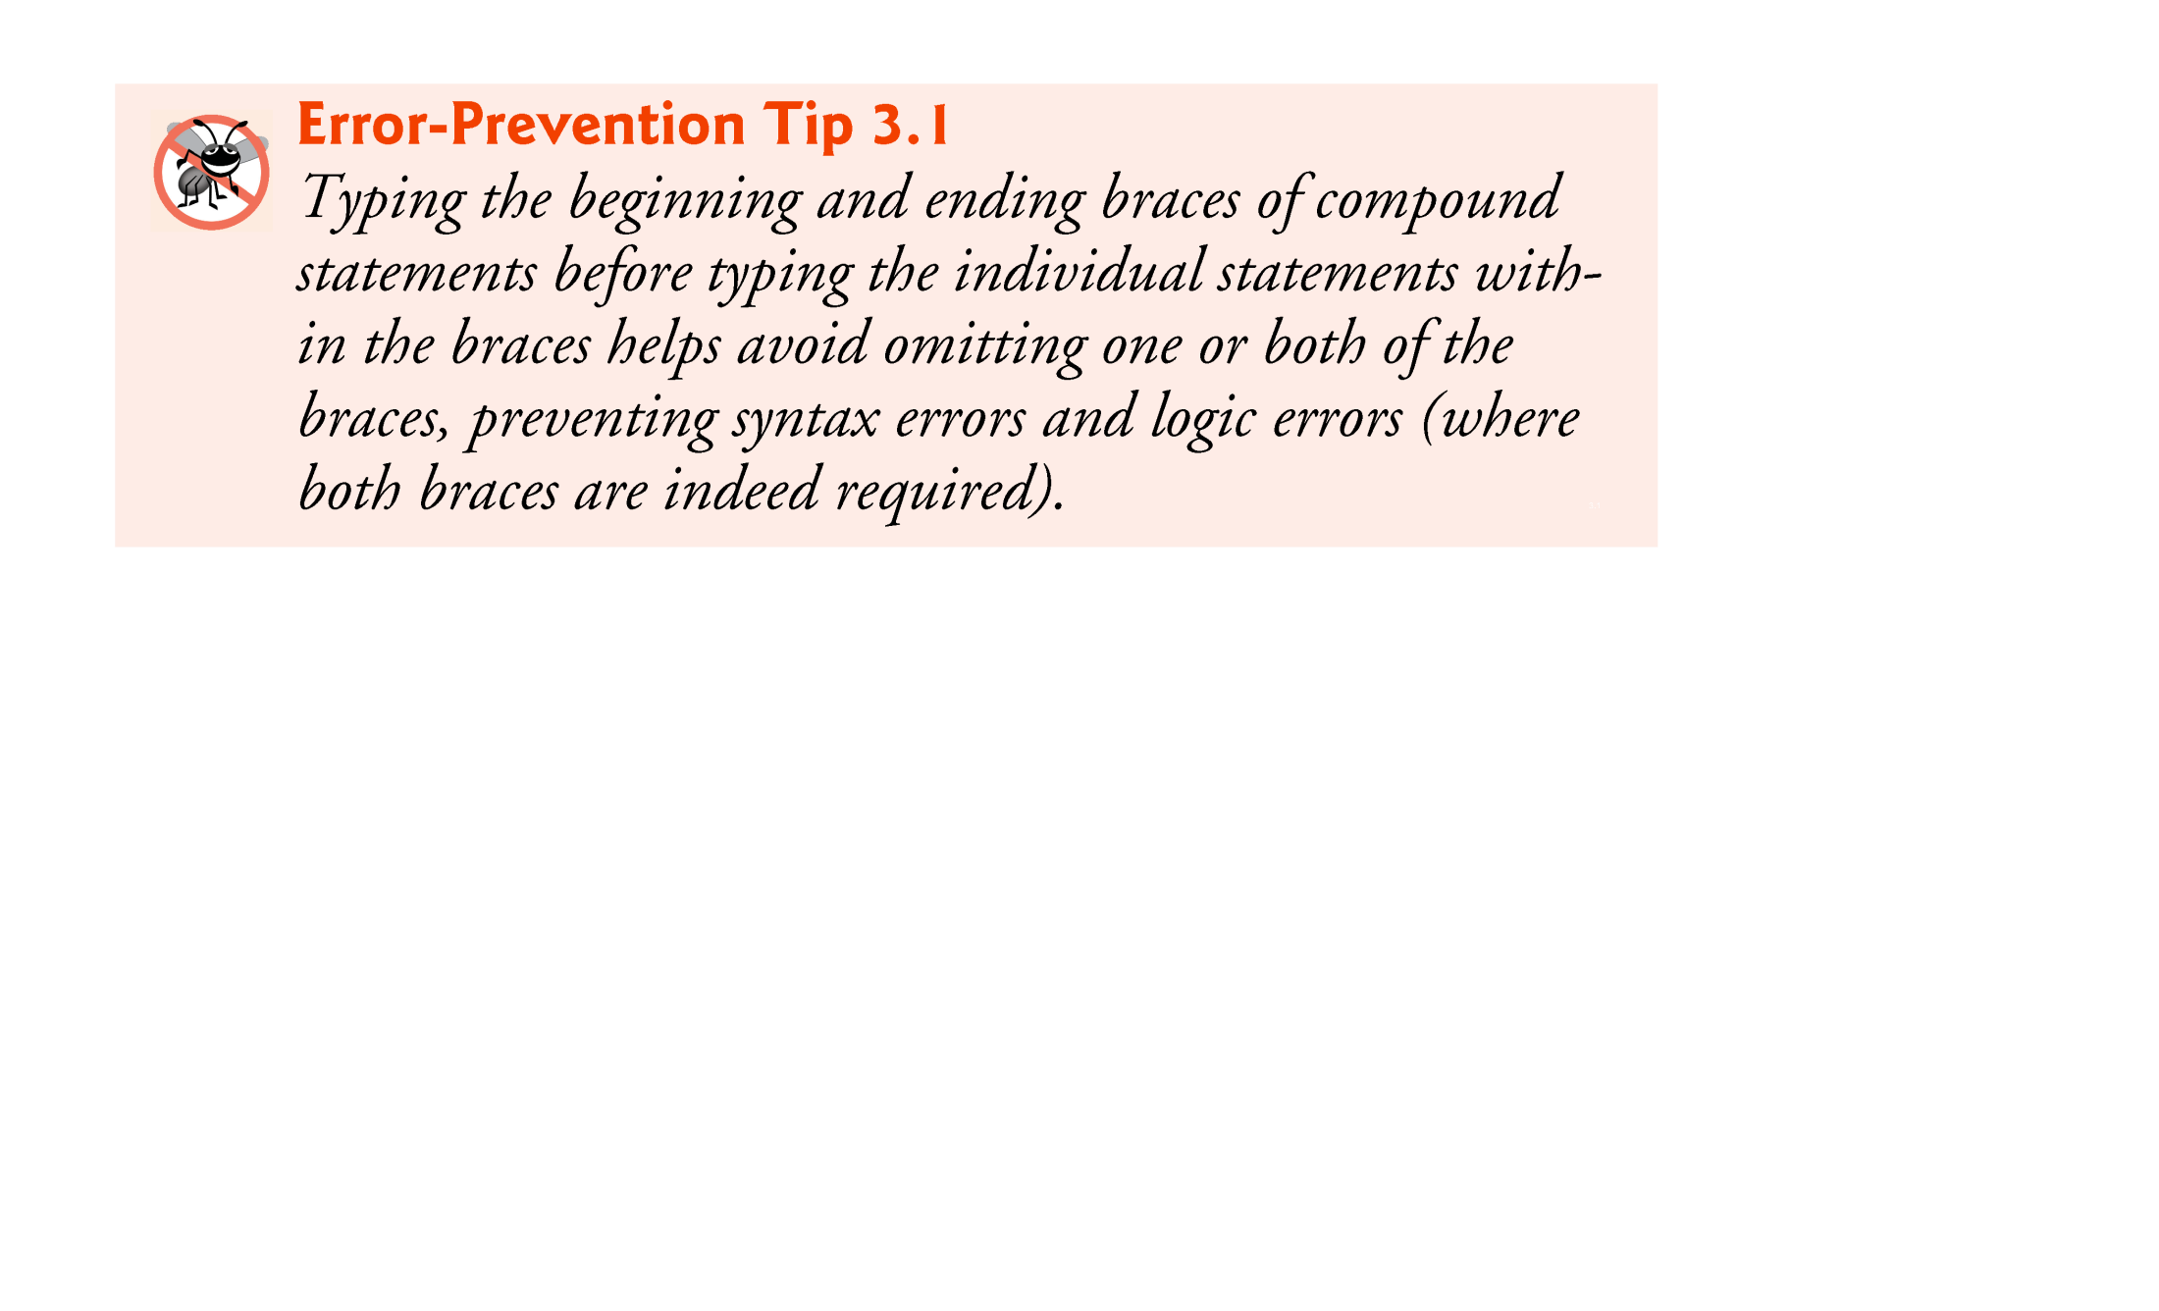

Slide 46
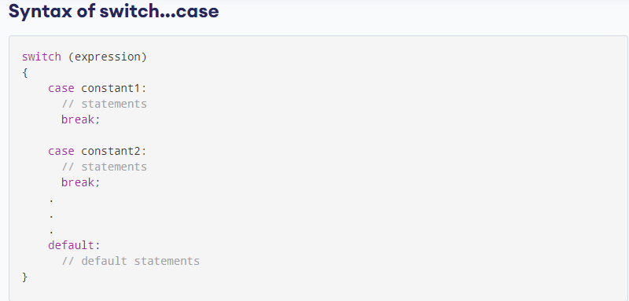
Switch Structure

Slide 47
// Program to create a simple calculator
#include <stdio.h>
int main() {
char operator;
double n1, n2;
printf("Enter an operator (+, -, *, /): ");
scanf("%c", &operator);
printf("Enter two operands: ");
scanf("%lf %lf",&n1, &n2);
switch(operator)
{
case '+':
printf("%.1lf + %.1lf = %.1lf",n1, n2, n1+n2);
break;
case '-':
printf("%.1lf - %.1lf = %.1lf",n1, n2, n1-n2);
break;
case '*':
printf("%.1lf * %.1lf = %.1lf",n1, n2, n1*n2);
break;
case '/':
printf("%.1lf / %.1lf = %.1lf",n1, n2, n1/n2);
break;
// operator doesn't match any case constant +, -, *, /
default:
printf("Error! operator is not correct");
}
return 0;
}

Slide 48
quiz
Write a c program that uses a switch structure to display the days of the week. Hint Sunday ==1.

Slide 49
Iterative structures
Loops….
  While Loop
  Do …. While Loop
  For Loop

Slide 50
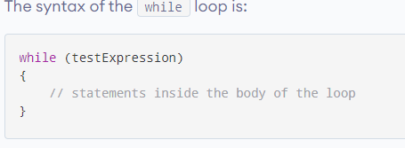
While Loop

Slide 51
How the while loop works
The while loop evaluates the test expression inside the parenthesis ().
If the test expression is true, statements inside the body of while loop are executed. Then, the test expression is evaluated again.
The process goes on until the test expression is evaluated to false.
If the test expression is false, the loop terminates (ends).

Slide 52


Slide 53
7. The while Repetition Statement
A repetition statement allows you to specify that an action is to be repeated while some condition remains true.
The pseudocode statement
  While there are more items on my shopping list
  Purchase next item and cross it off my list
describes the repetition that occurs during a shopping trip.
The condition, “there are more items on my shopping list” may be true or false.
If it’s true, then the action, “Purchase next item and cross it off my list” is performed.
This action will be performed repeatedly while the condition remains true.

Slide 54
7. The while Repetition Statement (Cont.)
The statement(s) contained in the while repetition statement constitute the body of the while.
The while statement body may be a single statement or a compound statement.
Eventually, the condition will become false (when the last item on the shopping list has been purchased and crossed off the list).
At this point, the repetition terminates, and the first pseudocode statement after the repetition structure is executed.

Slide 55
// Print numbers from 1 to 5
#include <stdio.h>
int main()
{
int i = 1;
while (i <= 5)
{
printf("%d\n", i);
++i;
}
return 0;
}

Slide 56
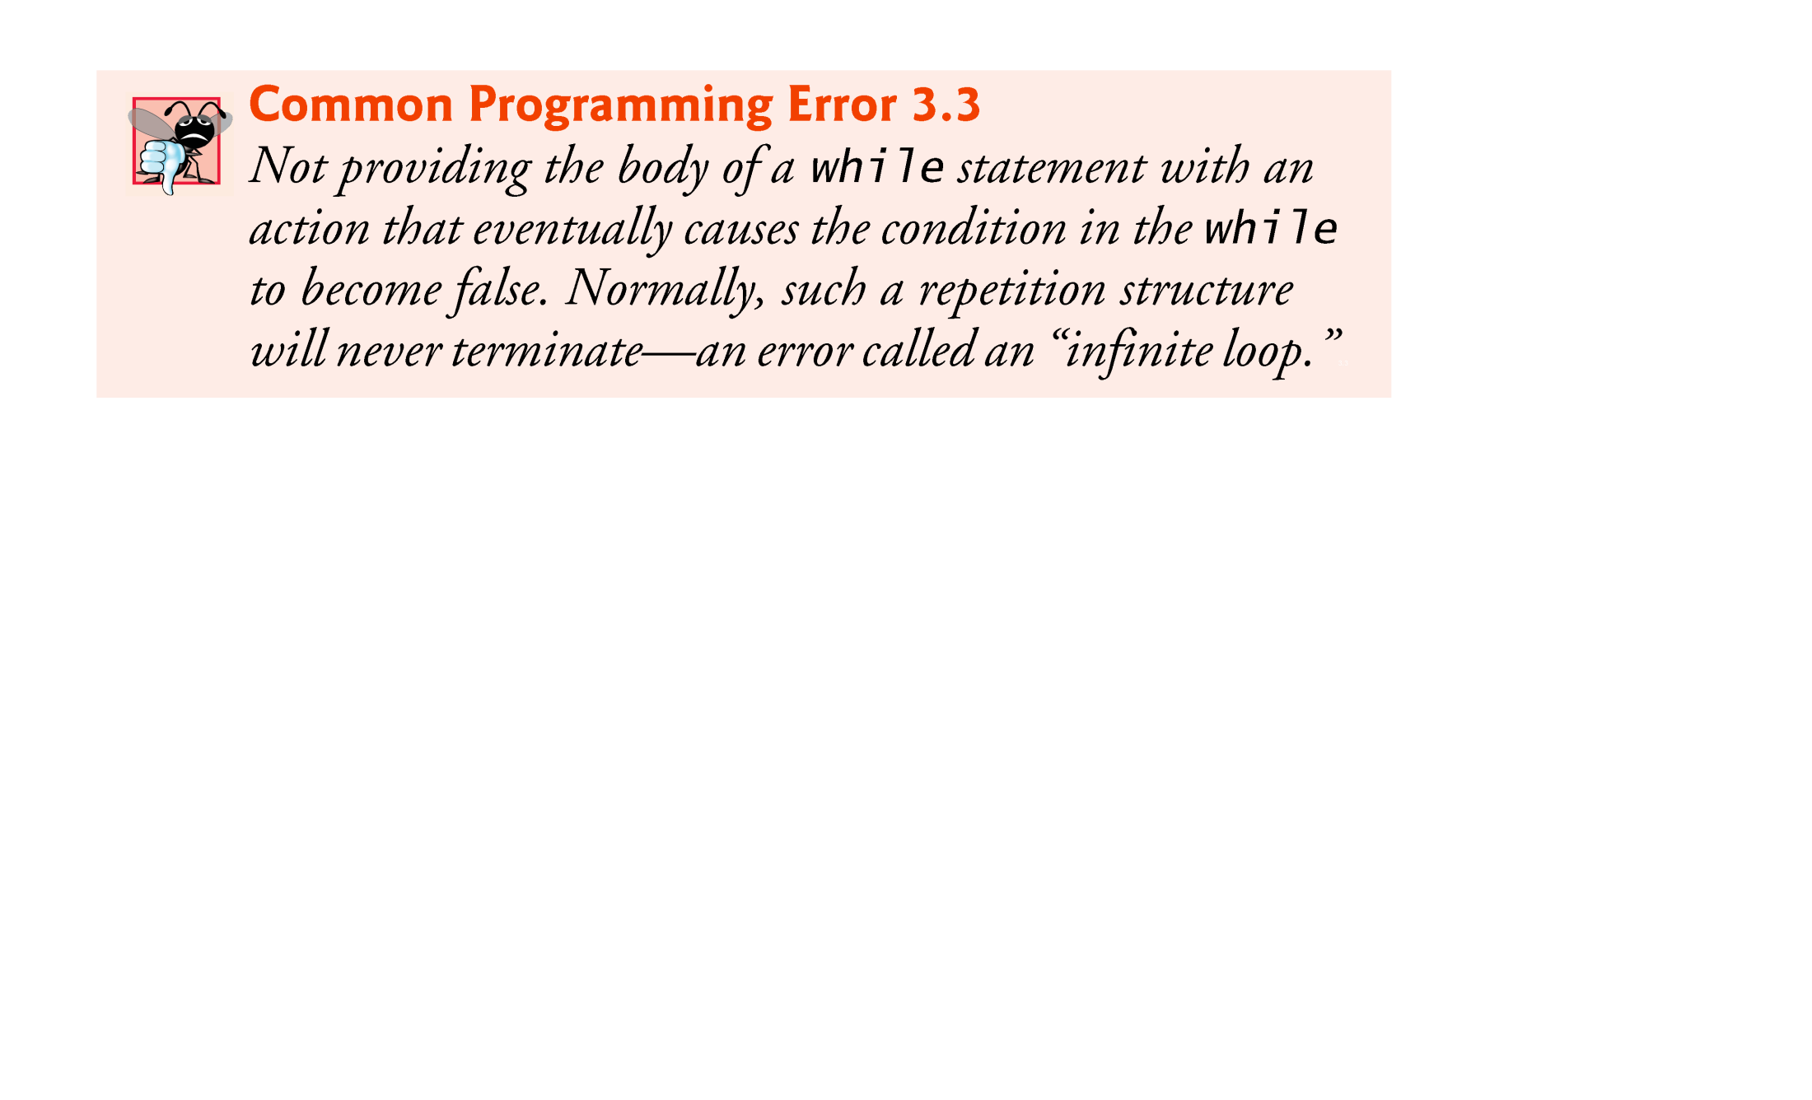

Slide 57
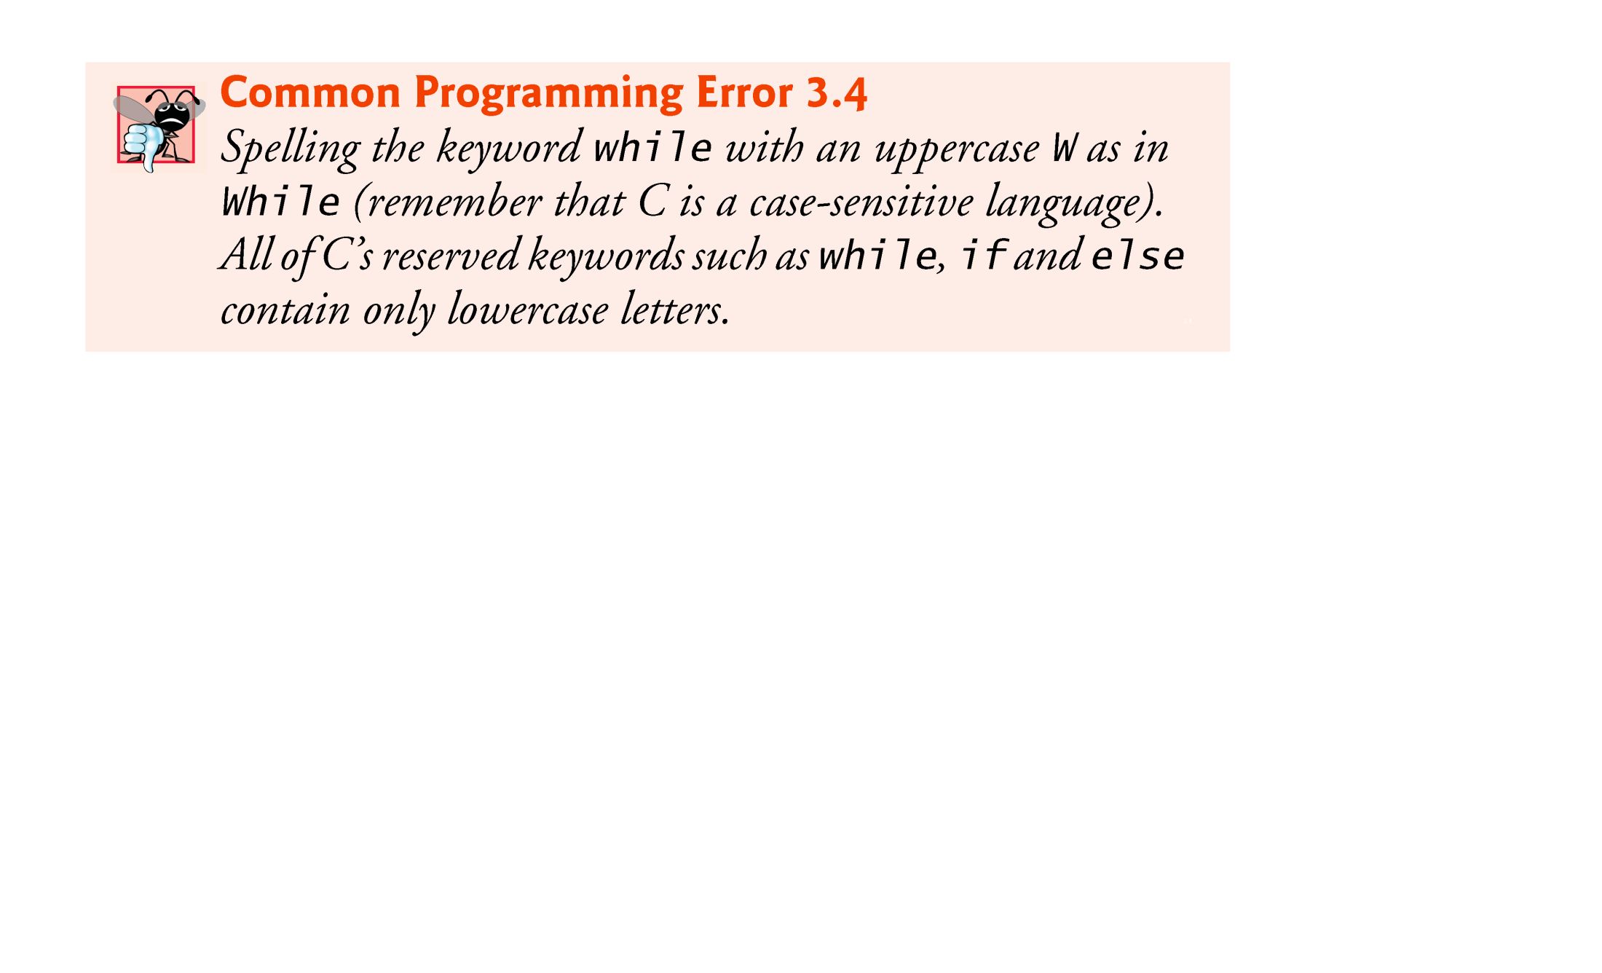

Slide 58
7. The while Repetition Statement (Cont.)
As an example of an actual while, consider a program segment designed to find the first power of 3 larger than 100.
Suppose the integer variable product has been initialized to 3.
When the following while repetition statement finishes executing, product will contain the desired answer:
    product = 3;
    while ( product <= 100 ) {
    product = 3 * product;
    } /* end while */
The flowchart of Fig. 3.4 nicely illustrates the flow of control in the while repetition statement.

Slide 59
7. The while Repetition Statement (Cont.)
Once again, note that (besides small circles and arrows) the flowchart contains only a rectangle symbol and a diamond symbol.
The flowchart clearly shows the repetition.
The flowline emerging from the rectangle wraps back to the decision, which is tested each time through the loop until the decision eventually becomes false.
At this point, the while statement is exited and control passes to the next statement in the program.

Slide 60
7. The while Repetition Statement (Cont.)
When the while statement is entered, the value of product is 3.
The variable product is repeatedly multiplied by 3, taking on the values 9, 27 and 81 successively.
When product becomes 243, the condition in the while statement, product <= 100, becomes false.
This terminates the repetition, and the final value of product is 243.
Program execution continues with the next statement after the while.

Slide 61
Do while Loop
The do..while loop is similar to the while loop with one important difference.
The body of do...while loop is executed at least once. Only then, the test expression is evaluated.

Slide 62
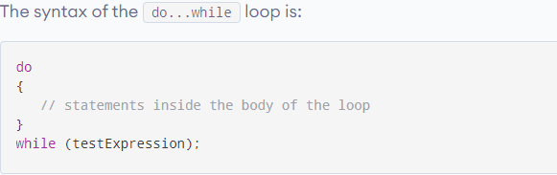

Slide 63
How does the do...while loop works?
The body of do...while loop is executed once. Only then, the test expression is evaluated.
If the test expression is true, the body of the loop is executed again and the test expression is evaluated.
This process goes on until the test expression becomes false.
If the test expression is false, the loop ends.

Slide 64
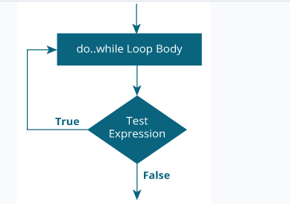

Slide 65
// Program to add numbers until the user enters zero
#include <stdio.h>
int main()
{
double number, sum = 0;
// the body of the loop is executed at least once
do
{
printf("Enter a number: ");
scanf("%lf", &number);
sum += number;
}
while(number != 0.0);
printf("Sum = %.2lf",sum);
return 0;
}

Slide 66
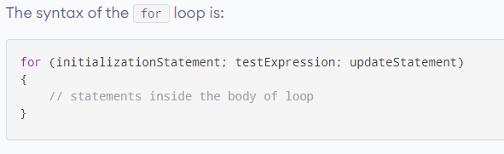
For Loop

Slide 67
How does the for loop works?
The initialization statement is executed only once.
Then, the test expression is evaluated. If the test expression is evaluated to false, the for loop is terminated.
However, if the test expression is evaluated to true, statements inside the body of for loop are executed, and the update expression is updated.
Again the test expression is evaluated.

Slide 68
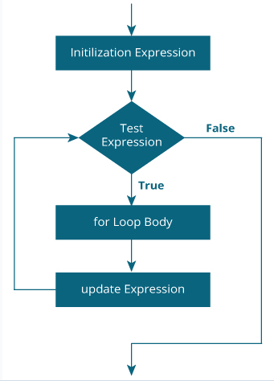

Slide 69
// Print numbers from 1 to 10
#include <stdio.h>
int main()
{
int i;
for (i = 1; i < 11; ++i)
{
printf("%d ", i);
}
return 0;
}

Slide 70
// Program to calculate the sum of first n natural numbers
// Positive integers 1,2,3...n are known as natural numbers
#include <stdio.h>
int main()
{ int num, count, sum = 0;
printf("Enter a positive integer: ");
scanf("%d", &num);
// for loop terminates when num is less than count
for(count = 1; count <= num; ++count)
{
sum += count;
}
printf("Sum = %d", sum);
return 0;
}

